Slide 1
GPAS & Billing
Ways of working
Extract for Guidewire consumption
Inception - Slide 2 to 4 agreed and approved with Beazley
Build - DRAFT version from Slide 5 onwards still under internal review

Slide 2
GPAS & Billing PROGRAM Release Trains
BILLING (Guidewire)
Responsible to implement the new Policy system in Guidewire across all Beazley Product variations & Lines of Business in Scope
MIGRATION
Responsible to provision all Infrastructure & Environments for a smooth Program execution e.g. Citrix machines, Scalable Dev, Test and Prod environments, DevOps support for continuous deployments & testing.
PROGRAM MANAGEMENT
LEGACY
Responsible for Overall Program Governance that includes Planning, Monitoring execution to Budget, Mitigate Risks & Issues.
Responsible to validate & sign-off Finance systems to the new GPAS & Billing implementation
Responsible to support Data Migration Release train enabling smooth migration of all Legacy Policy records into the new system
FINANCE
Responsible to implement the new Billing system in Guidewire to handle Billing cycle of all new Policies to be initiated under the new Policy system
POLICY (Guidewire)
INTEGRATION
Responsible to implement the in-scope integration elements necessary to ensure Guidewire operates as per business requirements.
Responsible to Build Data analytics on top of GPAS & Billing data meeting Business needs.
DOCS TOOLING
Responsible to implement all necessary communications to support Beazley’s business requirements.
TRAINING & BUSINESS READINESS
Responsible to Design and Roll out the new system to Business users, handle training, comms, stakeholder Mgmnt., risks and issue mitigation.
ARCHITECTURE
PRODUCT RATIONALISATION
Responsible to Rationalise product set for Foundation release and agree a framework for rationalising the remaining GPAS Products.
Responsible to Migrate all Legacy Policy data at renewal into the new Guidewire system.
TESTING
Responsible to make sure we are deploying code to production that meets Business requirements & Program and Product quality standards
DATA
BUSINESS DESIGN
Responsible to create a centre of excellence for Beazley E2E process and journey design, ensuring consistency and quality.
Responsible to create a System Architecture for the Program that is Robust, Industry standard, Scalable and meets Beazley’s requirements
ENVIRONMENTS & INFRASTRUCTURE
Key:
Defined Release trains/Teams
TBC Release trains/Teams

Slide 3
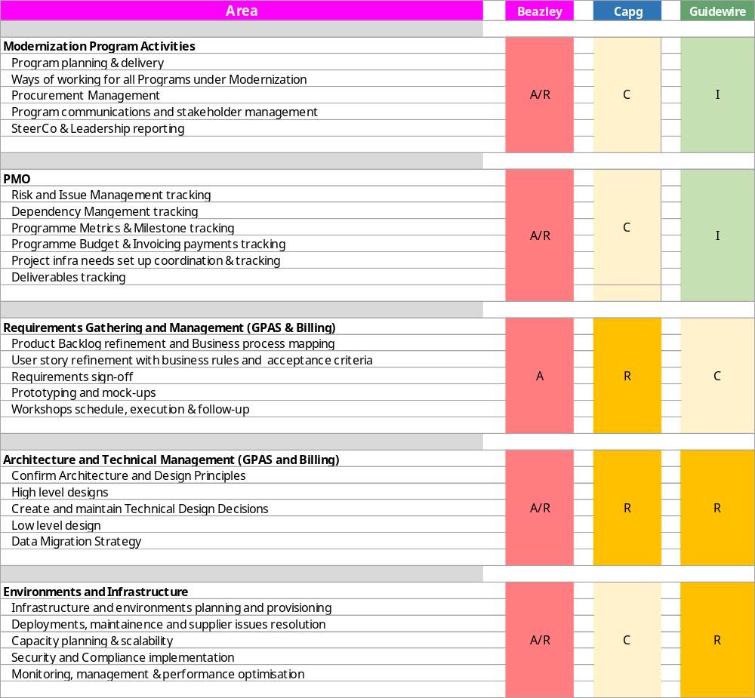
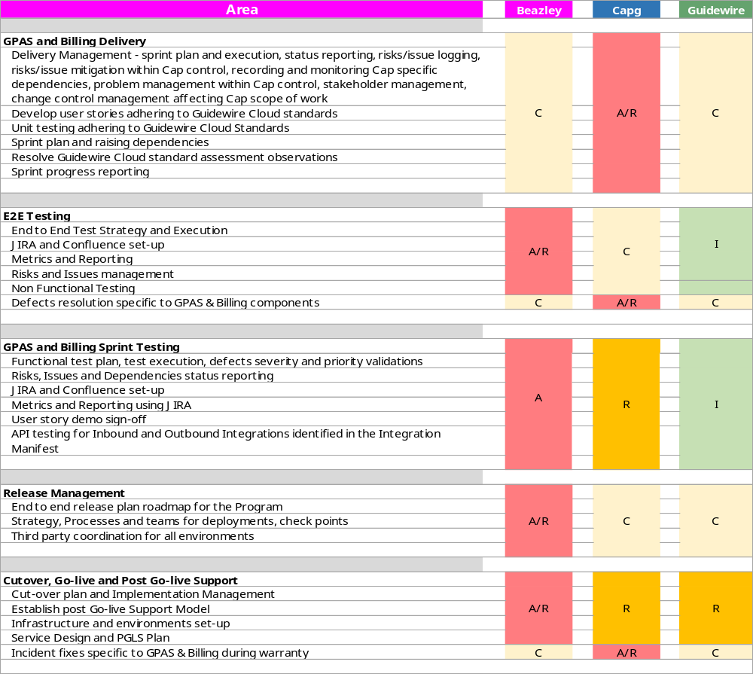
KEY AREAS – raci [1]
Key
A | Accountable | Authority and decision making
R | Responsible | Responsible for actualisation of the task
C | Consulted | Engaged stakeholder, consulted in decisions, delivery and approach to enable their input
I | Informed | Informed stakeholder receiving updates and outputs only

Slide 4
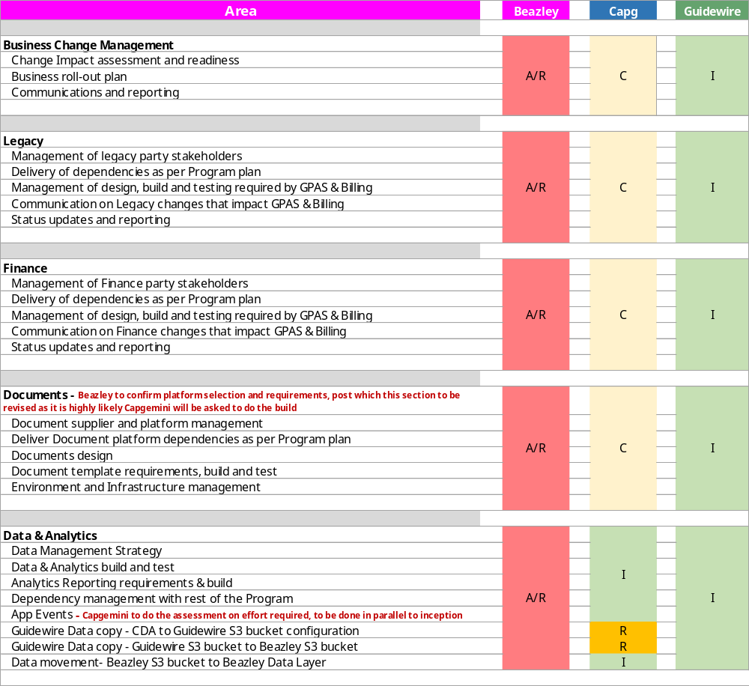
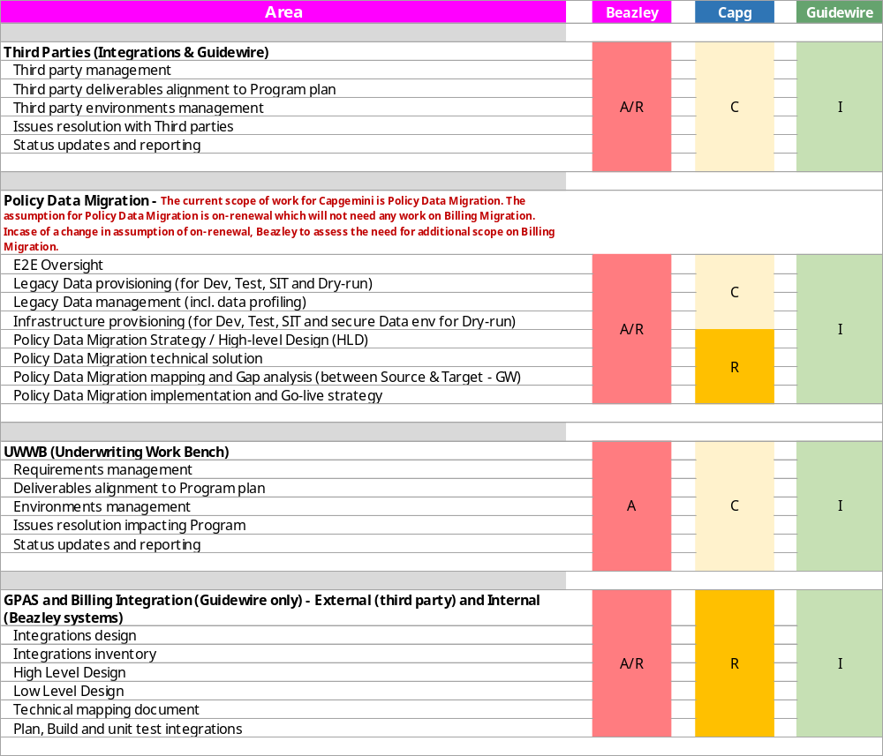
KEY AREAS – raci [2]
Key
A | Accountable | Authority and decision making
R | Responsible | Responsible for actualisation of the task
C | Consulted | Engaged stakeholder, consulted in decisions, delivery and approach to enable their input
I | Informed | Informed stakeholder receiving updates and outputs only

Slide 5
THE 3-way collaboration for success
For the success of GPAS & Billing Program, It is critical for Capgemini-Beazley-Guidewire to work in close collaboration across phases of the Program execution.
BEAZLEY
GUIDEWIRE
CAPGEMINI
Finalize & maintain Product contract with Guidewire
Conform requirements to OOTB
Timely approvals pending architecture or design considerations
Review code assessment reports
Adhering to the Release management prescribed by Guidewire
3 Way Cadence on Need basis
Weekly Cadence
Deploy certified technical team
Build GPAS & Billing Code on SaaS platform
Conform to Guidewire Cloud Coding standards
Resolve Cloud assessment observations
Collaborate for all major design decisions
Provide SaaS platform to deploy GPAS & Billing solution
Provide Dev and Prod environments
Perform Code assessments & Design validations
Updates on new product version releases
Provide SME support as per the agreements with Beazley & Capgemini
Weekly Cadence
KEY SUCCESS FACTORS
Align requirements to Product
Design and Build to standards
Collaborate on decisions

Slide 6
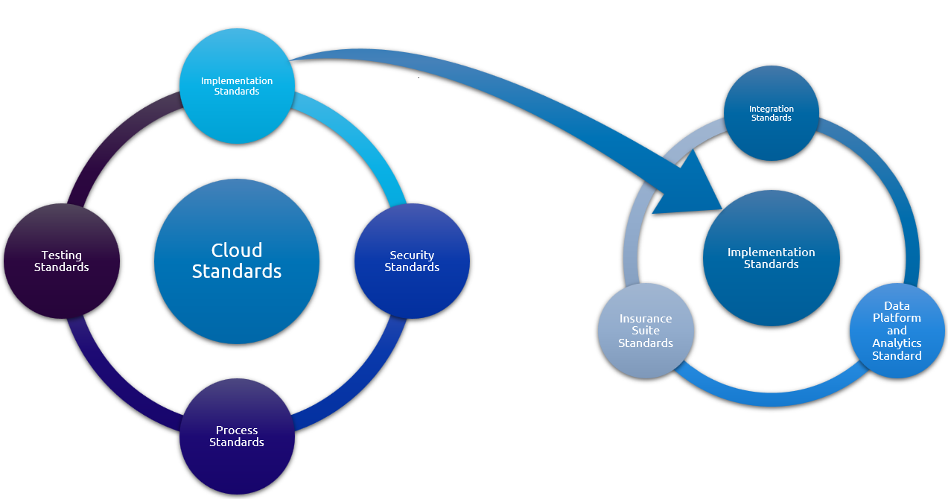



Guidewire Cloud Assurance Assessment (CAA)
Cloud Assurance Program Goals are:
Assess and report adherence to Cloud Standards
Enforce remediation of Cloud Standards violations by the implementation team
Competency Assurance - Periodic reviews conducted to ensure all Developers and Analysts are appropriately trained, certified and each workstream has the required Lead to Associate ratio (1:3). Managed by Guidewire Education team
Overview:
Purpose: Validate if developed code conforms to Guidewire Cloud
standards
Frequency: Monthly, at the end of each Sprint/Stabilization/Pre-Go-live
Assessment Methods:
Automated Cloud Assurance is executed in TeamCity to run inspection on all Cloud Standards that have assessment type “Partial/Fully Automated”.
Additional manual code review of Cloud Standards that have assessment type “manual” are carried out by the Guidewire Cloud Assurance team
Outcome: Is a Cloud Assurance Report:
GW provides report on custom code that violates Cloud Standards
Provides suggested remediations in the Guidance section of the Cloud Assurance Report
Capgemini and Beazley teams are provided access to the report
Review, Resolution & Reporting Process:
  Issue Identification:
    Guidewire team identifies and documents issues in the Cloud Assurance Report
  Assigning observations to developers
    All Cloud Assurance Report items are moved to JIRA board, assigned priority, and assigned to developers for fix
    Any conversations on reported issues with Guidewire are completed by team ad-hoc and almost immediately
  Reporting:
    The Guidewire observations fix status is reported via JIRA in the Sprint closure review provided to Beazley

Slide 7
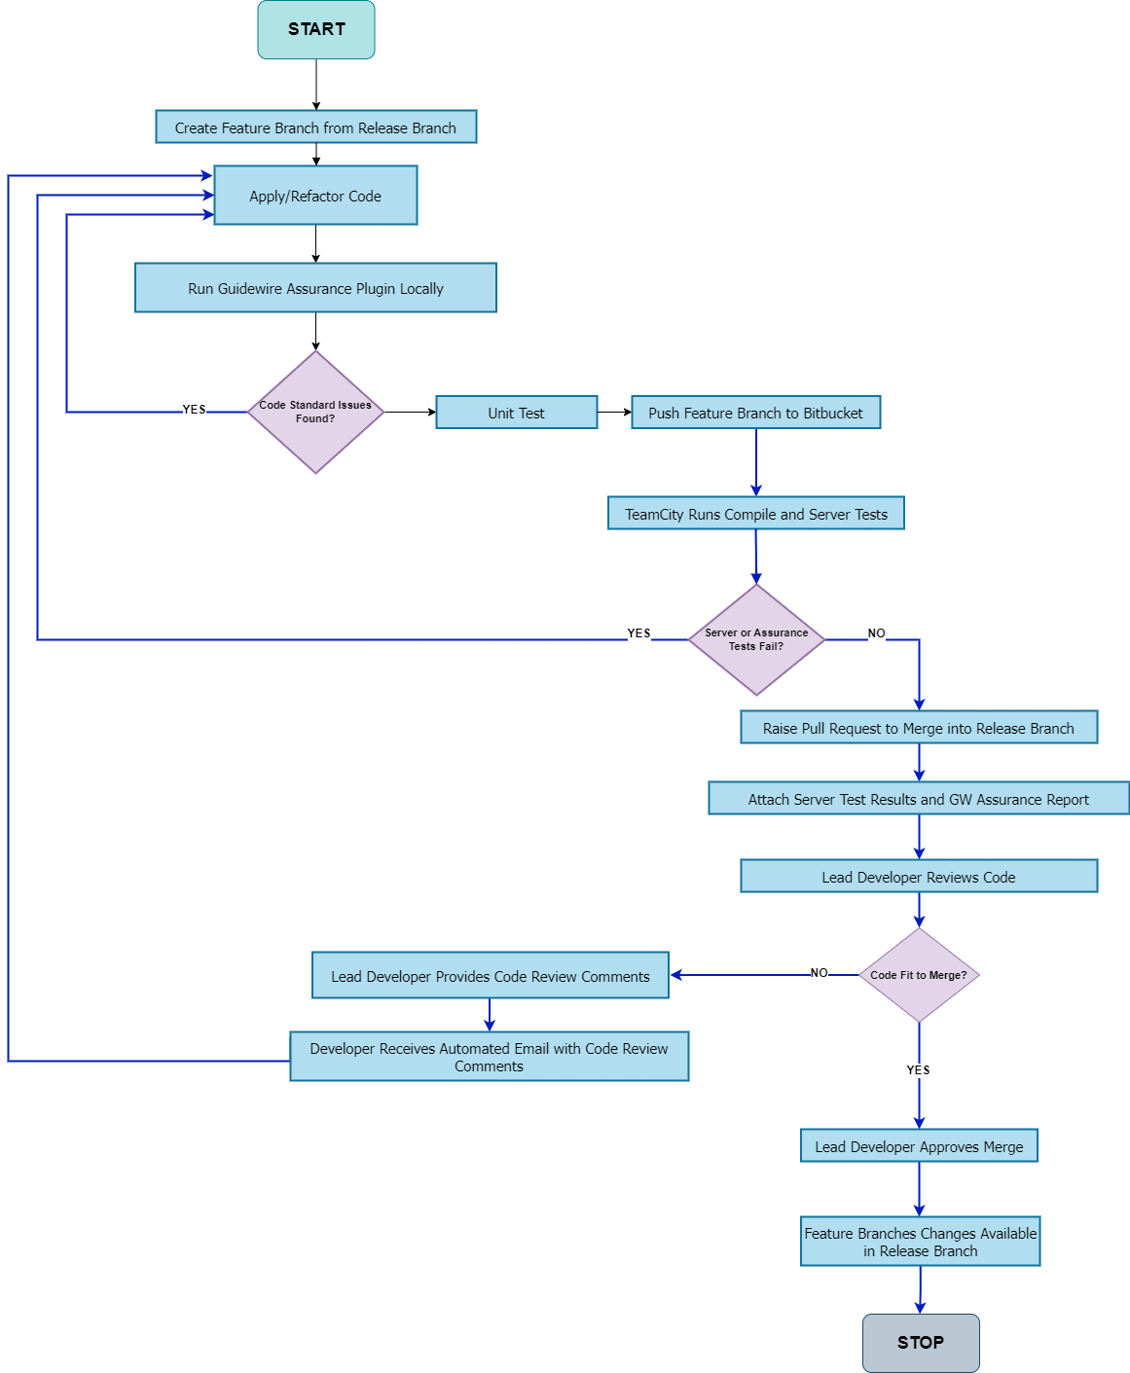
Developer Workflow
Feature Branch Creation and Code Changes
  Developer creates a Feature Branch from the release branch and applies changes to the code.
Developer Code Inspection
  Developer runs the Guidewire Assurance plugin to find deviations from cloud standards.
  If any code standard issues are reported by the plugin: Developer fixes the issues and re-runs the Guidewire Assurance plugin.
Pushing to Bitbucket and CI/CD Pipeline
  Developer pushes the Feature Branch to the Bitbucket repository and waits for the TeamCity CI/CD pipeline to run.
Handling Test Failures
  If server or assurance tests fail in the TeamCity CI/CD pipeline: Developer rectifies the code in Guidewire studio , pushes the changes to the Feature Branch and continues this cycle until the server test and assurance test pass in TeamCity.
Pull Request and Code Review
  Developer raises a Pull Request (PR) to merge the Feature Branch into the release branch.
  Lead developer provides code review comments within the PR and creates a task for the developer to refactor the code.

Slide 8
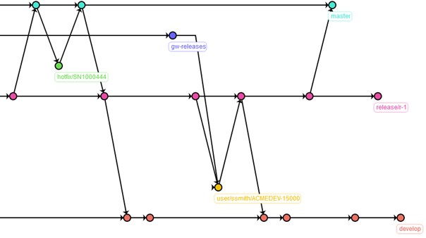
Git Branching and Merging Strategy
master branch: Updated post release or during emergency fixes
Guidewire Standard: Follows "Guidewire GW-MTH-1084 Branching Strategy for Guidewire Implementation Projects."
  Ensures robust, consistent process for managing parallel code changes within and across releases.
  Intended for technical leads and implementation consultants.
  Uses Git repositories for version control of source code and software artifacts
  Managed using Guidewire-provisioned Bitbucket Server instance.
  Implements the branching strategy described in the standard.
Branching Strategy Overview:
  Production Branch (master):
    Single production branch named master. Contains out-of-the-box product and configurations at project start.
    Updated only during release activities or emergency fixes by senior developers.
gw-releases branch: Owned by GW
release branch: Created when the project enters stabilization phase
hotfix branch: Used for high-severity production incidents
user story branch: Changes pertaining to a user story developed in the user story branch
  Product Release Branch (gw-releases):
    Created off master at project start for new product versions and owned by Guidewire Customer and Cloud Operations.
develop branch: The mainline branch, contains all code across all releases
  Defect Branches:
    Created off develop or release branch for defects.
  Project Release Branches (release/r-*):
    Used to stabilize code before moving to production and Named as release/r-{release_number}.
  Hotfix Branches (hotfix/*):
    For high-severity production incidents and created off master and named hotfix/{id} and merged back to master and other branches by authorized developers
  Mainline Branch (develop):
    Single mainline branch named develop, created off master and contains all code across all releases.
    Accessible to all team developers for merging.
  User-Story Branches:
    Created off develop or release branch for user stories.
  Note:
  Code management strategy will be revisited once the single instance vs multiple instance code base approach is finalized (US region and UK region specific)
  For the initial foundation release, there will be a single branch (develop)

Slide 9
Guidewire updates Process
Capgemini’s GUIDEWIRE UPDATES SCOPE
Capgemini will Update Beazley’s Foundation Release to have the latest GW v10 release of PC and BC components
To best protect the release delivery timeline, Version Update will be taken-up during Sprint development phase and not in Stabilisation phase (E2E+UAT)
To keep the Update efforts within the plan, Beazley implementation must stay within 10% customization limit
Updated code base will undergo regression testing, deployments into higher environments & developer synch-up activities
GUIDEWIRE LAYER AND CUSTOMER LAYER
The Guidewire layer and customer layer are defined to designate clear ownership of files that are contained within the InsuranceSuite artifact
For every Version Update cycle, Guidewire will perform the Guidewire Layer update, followed by Capgemini doing the customer layer update and regression testing
Indicative timeline for each Update activity
Updates by Guidewire – 1 to 2 weeks
Updates by Capgemini for Beazley code base – 1 to 2 weeks
Regression testing across dev & test environments within build phase – 1 to 2 weeks
Final sign-off by development team & developer workspace synch-up – 1 week

Slide 10
Sprint – DoR and DoD
Sprint Definition of Ready
Sprint Definition of Done
Sprint backlog hand off (technical and functional clarifications with PO/Business SME) is complete and user stories are in compliance with Definition of Ready
Sprint backlog is based on the available sprint capacity (Build & QA hours available)
Product Data Model requirements are finalized
Signed off HLA made available by the architecture team wherever applicable ( applicability of this is determined during elaboration of requirements)
All dependencies have been resolved. Dependency items are agreed for all third-parties (internal and external)
Environment configuration completed, and access setup done for workstream members
All user stories and sub tasks within a user story are in Done status
Completed user stories follow the User Story Definition of Done or any exception is agreed with Beazley
Stories not in ‘Done’ status have an agreement between Capgemini and Beazley to be reassigned either to backlog or an identified sprint
Test execution is complete in Jira with no test cases in ‘To Do’ status or if any exception is agreed with Beazley
High priority or severity defects have been either closed or there is a mutually agreed fix plan with Beazley for the open defects
Sprint completion reports are shared with Beazley stakeholders – Business SME/PO and Program Management team
Sprint Retrospective conducted and agreements or actions are documented
Automation testing (if applicable) has a coverage to the requirement level as defined in the test strategy
PO – Product Owner
ETL – Extract Transform & Load
HLA – High Level Architecture
Please note that the Sprint DoD validation will happen in the week after the last week of the Sprint development

